Slide 1
Compton Unified school district School-To-Career
CAlifornia Promise (ages 14 – 16 years)
Workability I (Middle/high school)
transition partnership program (Juniors & seniors)

Slide 2
california promise
California Promoting the Readiness of Minors in Supplemental Security Income
CaPROMISE is funded through a cooperative agreement U.S. Department of Education, Office of Special Education Programs (OSEP) Grant #H418P130003.

Slide 3
UCLA TARJAN Center Tour

Slide 4
Cypress College Tour

Slide 5
Cypress College Tour

Slide 6
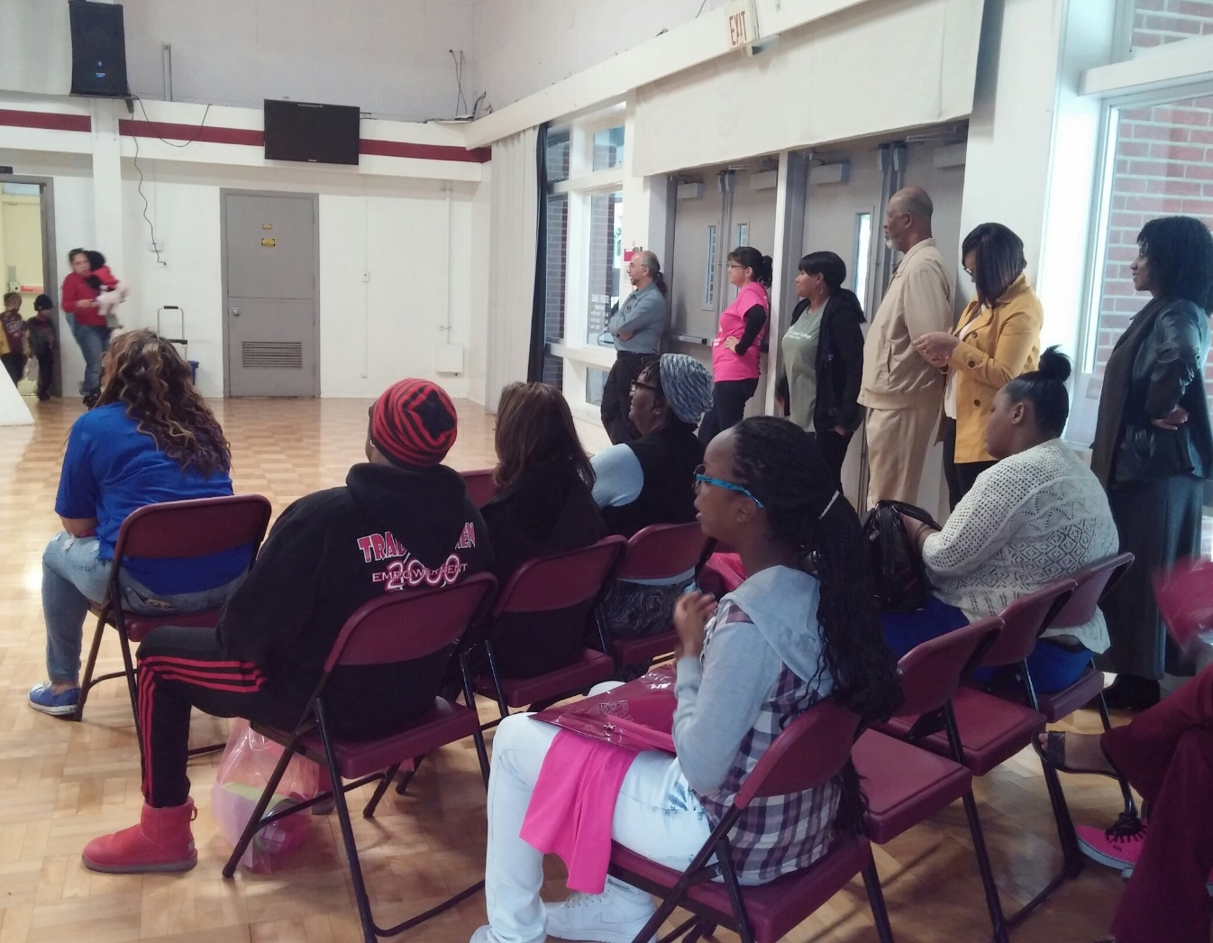
Women in Technology Workshop El Camino college – compton center

Slide 7
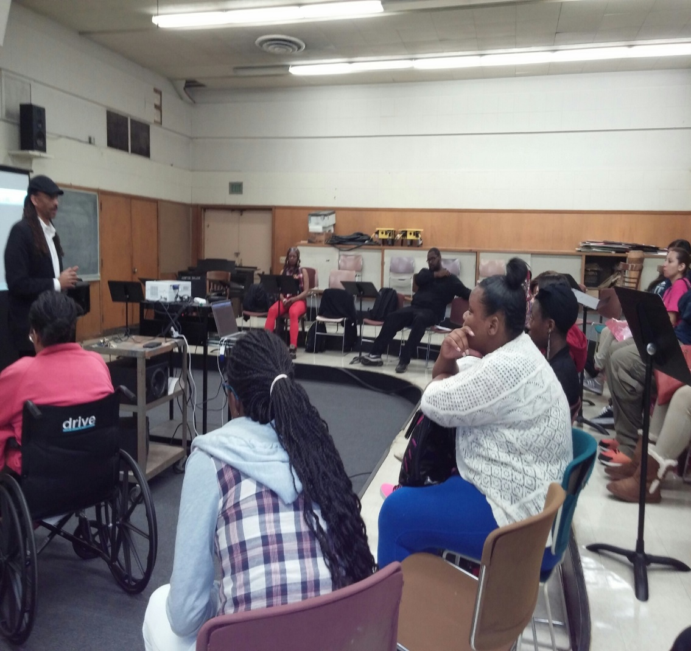
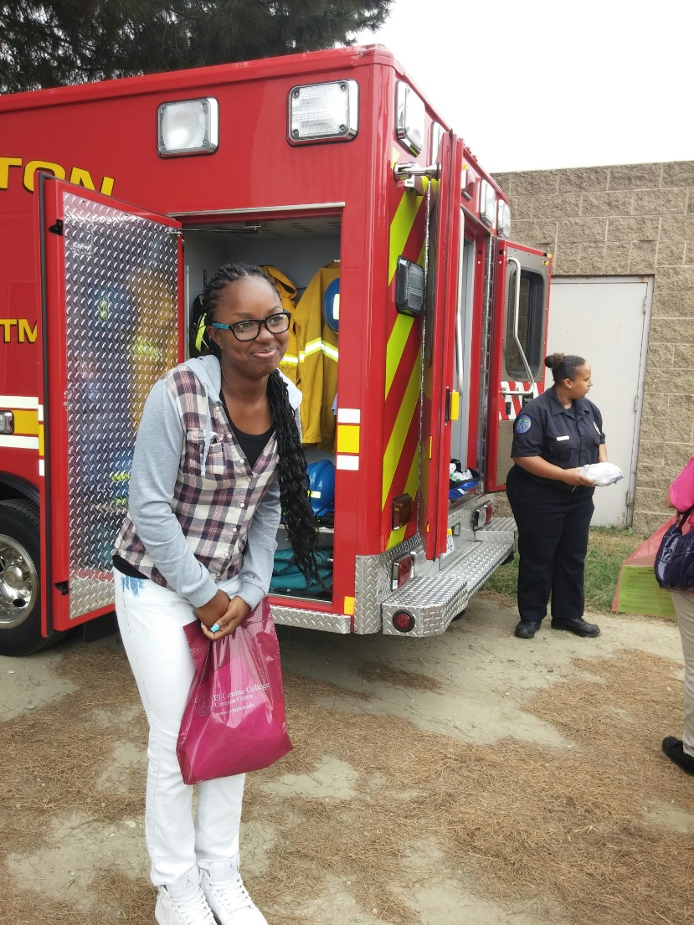
E.M.T. training and Music Technology Workshop

Slide 8
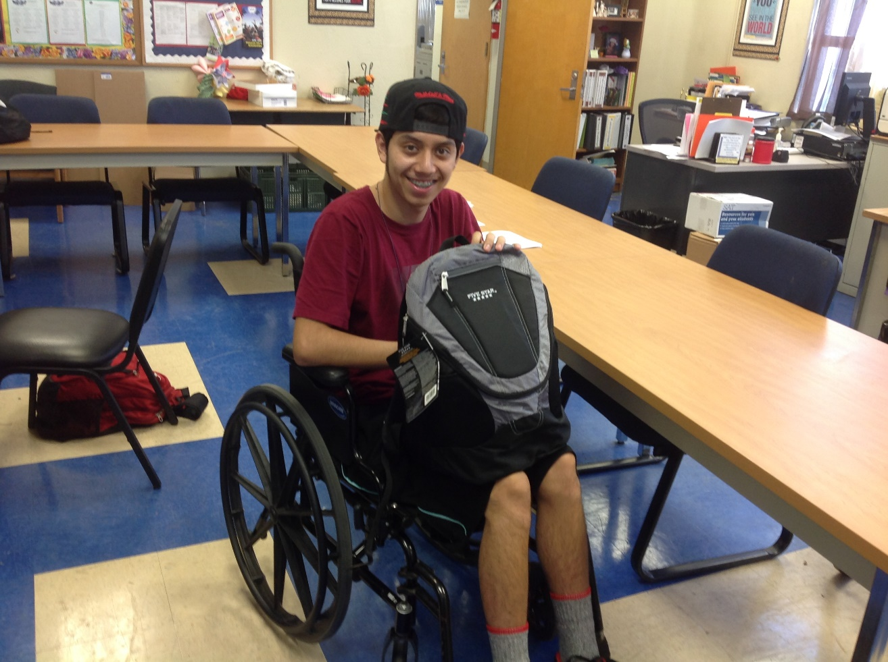
Backpack Give away

Slide 9
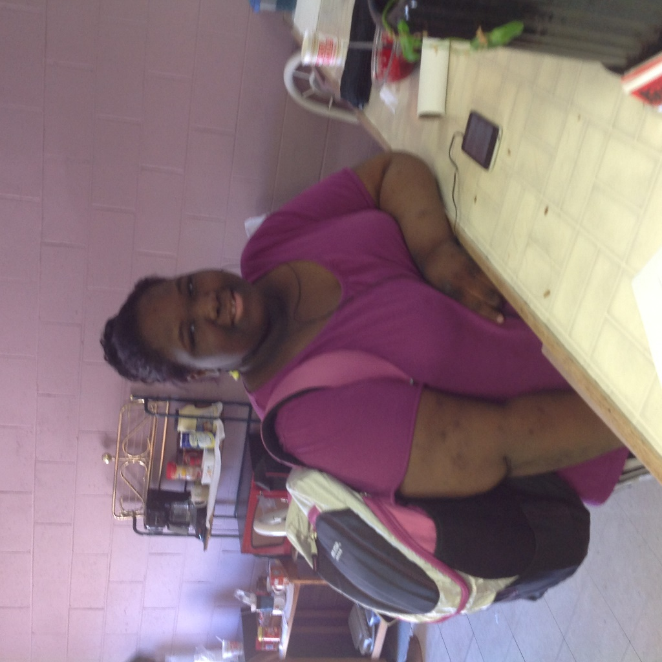
Backpack give-away

Slide 10
Interviewing skills training Compton Worksource Center

Slide 11
Workability I Middle and high school
Services 300 high school students and teachers through paid job-training opportunities, vocational resources for the teachers, career assessments, and bus tokens for community exploration.
Services 220 middle school students and teachers through career assessments, transition strategies, and career exploration through speaker bureaus and field trips.

Slide 12
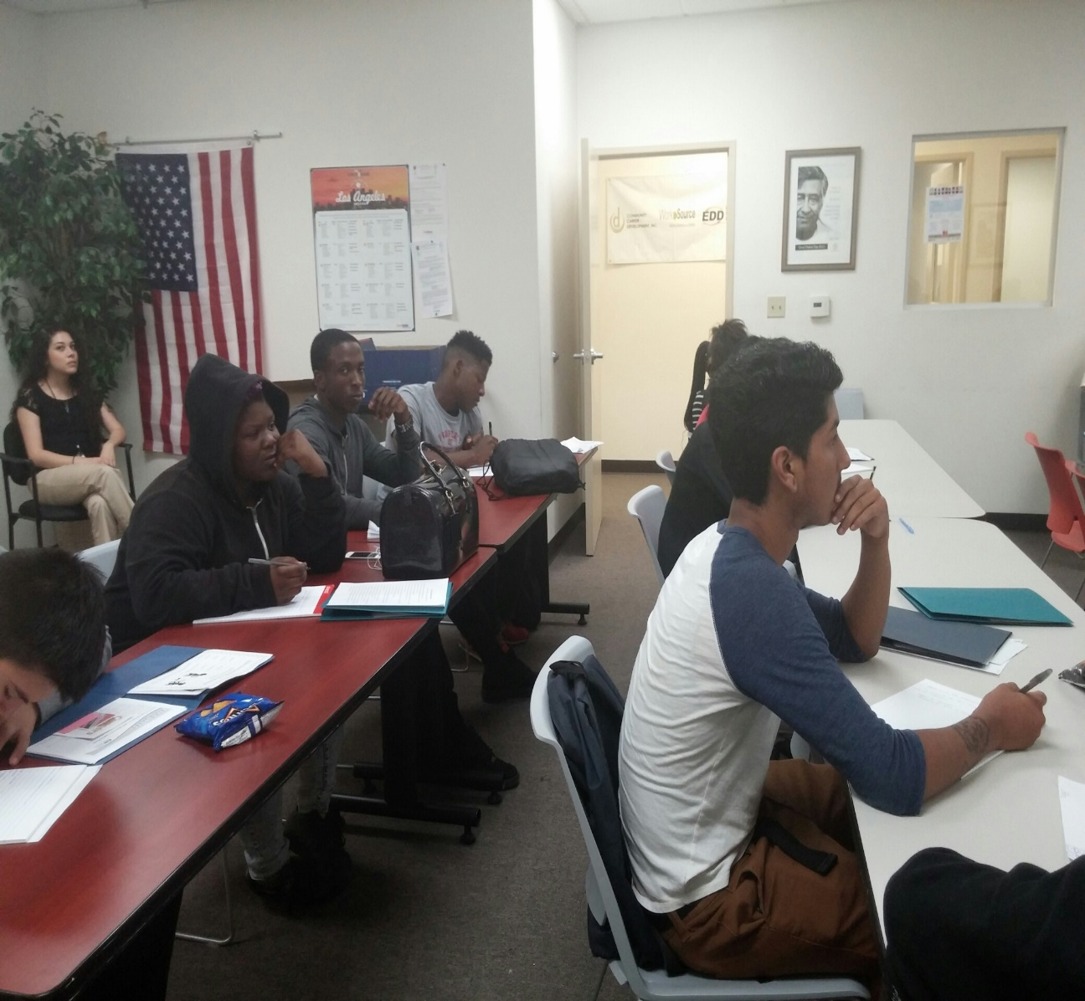
Job Trainings

Slide 13
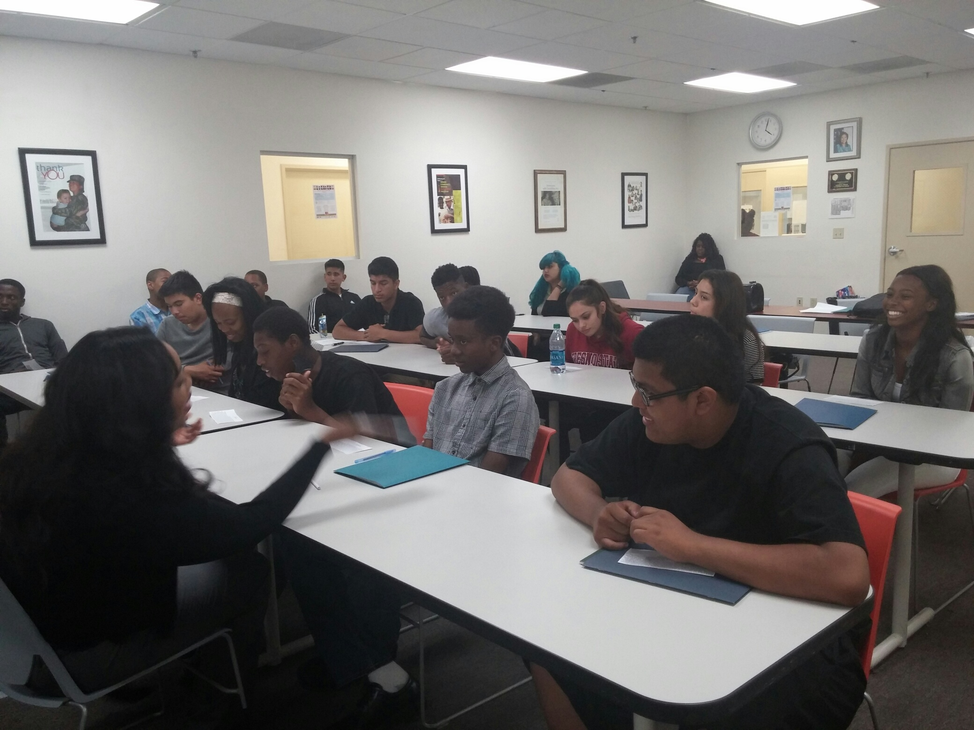
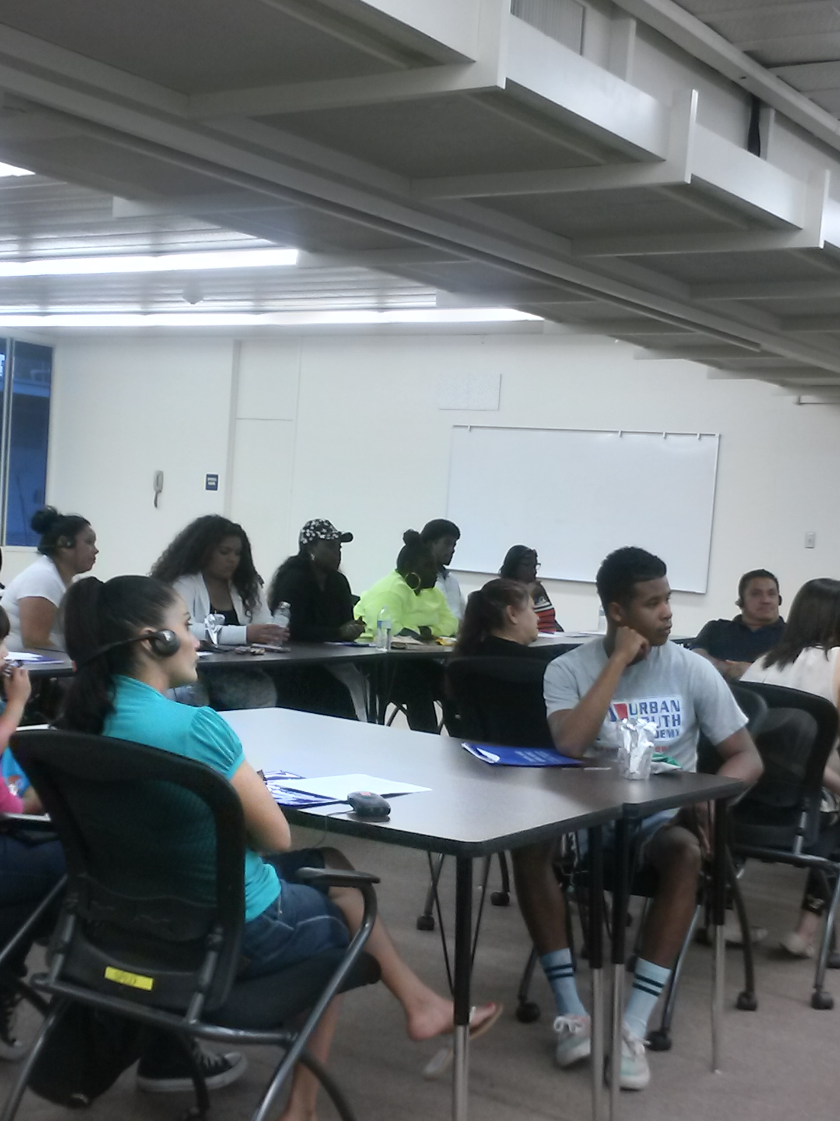
Transition Partnership Program (TPP)
TPP works primarily with juniors and seniors in high school providing them with a link to the Department of Rehabilitation (DOR).

Slide 14
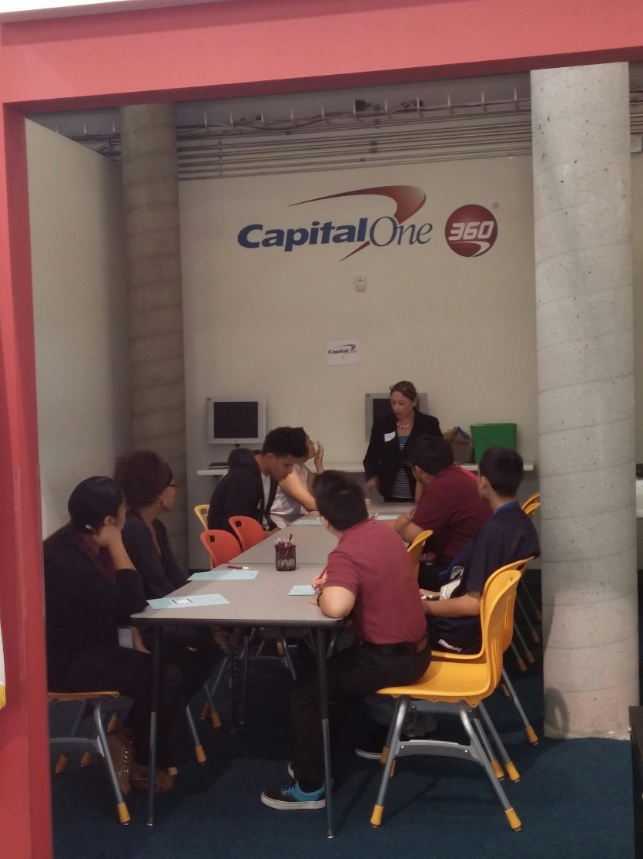
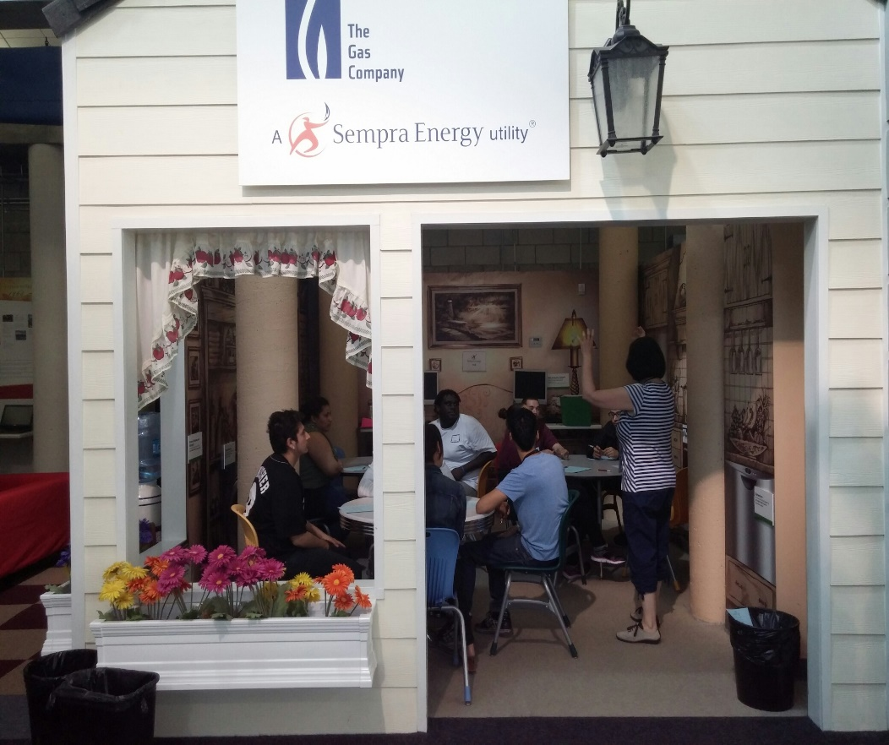
J.A. Finance Park Workshop

Slide 15
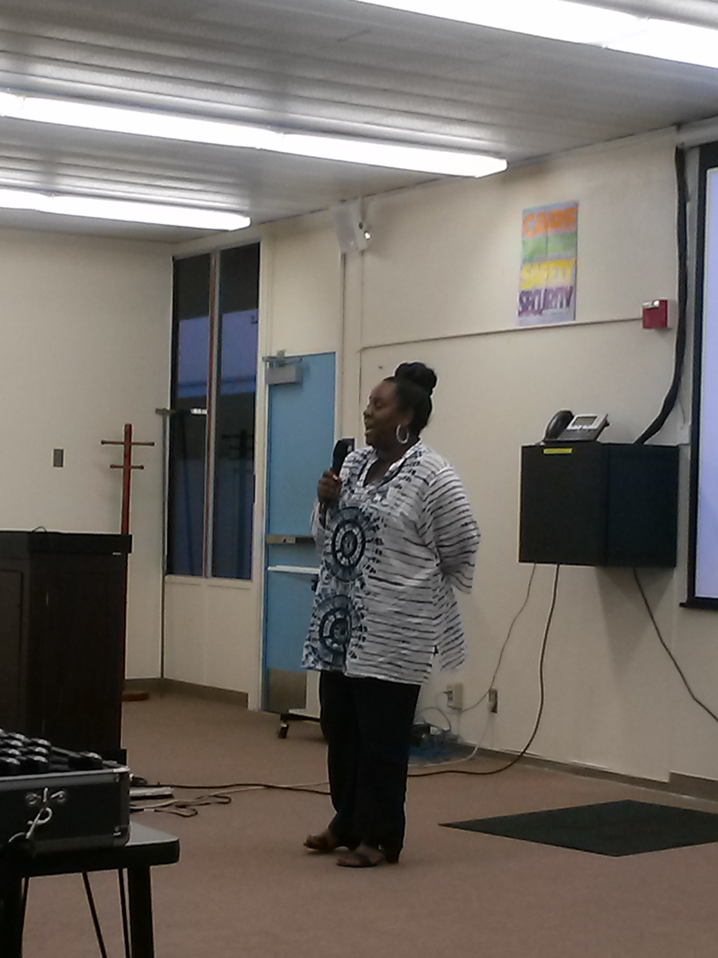
Transition FOCUS

Slide 16
In partnership
Independent Living Center (ILC)
Regional Center
Family Resource Center (FRC)

